Slide 1

Zomato: Analyzing Restaurant Success
Eric Praniewicz | TripleTen BIA |
Final Project

Slide 2
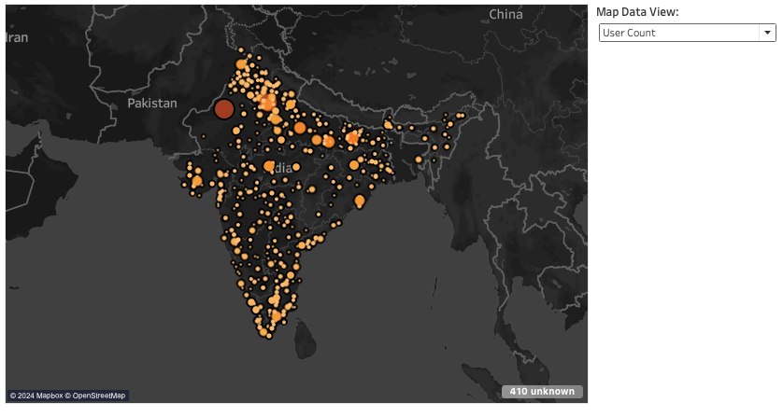
Analysis + Report
Please use this report as a tool to follow along as you work your way through the dashboards in tableau
This report will provide key insights discovered using the tableau dashboards
Use this link to open Tableau Woorkbook

Slide 3

Zomato by the numbers
Zomato currently hosts nearly 150,000 restaurants across India, according to datasets provided
This report is a study in popularity of restaurants on the Zomato platform
Which restaurants are popular?
Are there any specific factors that drive popularity on Zomato?
Circle graph depicting each individual restaurant listed on Zomato; circle size depicting revenue amounts

Slide 4
Analysis outline
Identifying Popular Restaurants
Popularity measured by total count of orders per restaurants, count of orders over time, quantity of items ordered, count of users ordering from top restaurants
Revenue Analysis
Are restaurants with highest order counts also top revenue earners?
Popularity of Menu Items per Price Point
Analyzing the “Why” behind restaurant popularity
Location analysis by city
Analysis of Menu Offerings
Cuisine Types
Veg v. Non-Veg options
Popularity of menu items across the app
Study of Restaurant Ratings v. Order Counts

Slide 5
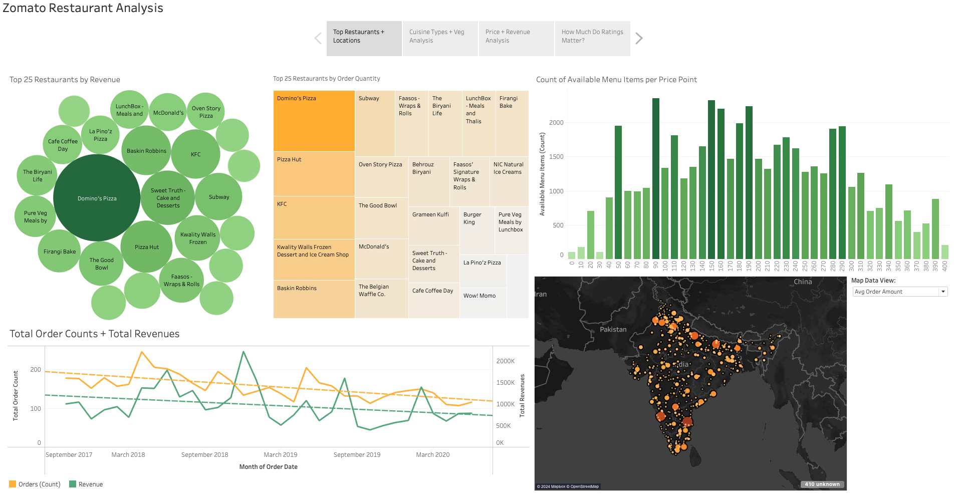
The first dashboard depicts the top 50 restaurants by revenue as well as the top 50 restaurants by order count (Top left, Top Middle)
This dashboard also depicts total revenues and order counts through time according to collected data as well as a breakdown of popularity of items per price point (Bottom left, top right)
Location data can be shown for revenue, order count, average order amount and location of users(Bottom Right)

Slide 6
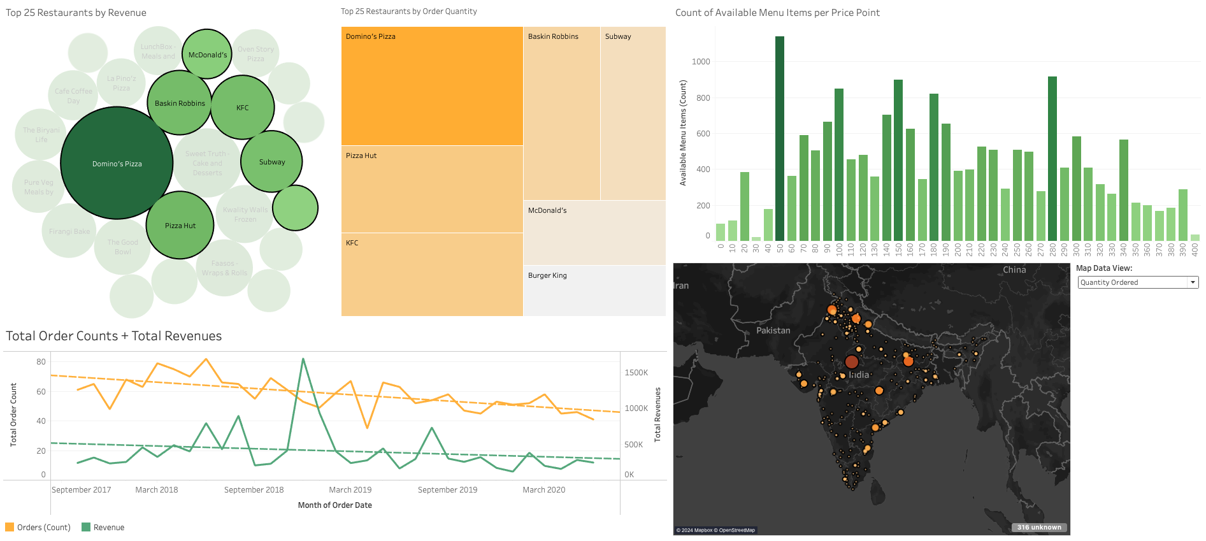
American cuisine chains dominate top revenues and order quantities.
High variety of price points for menu items, however a significant portion are priced at or below 280, particularly high number of options priced at 50 - 60.
Concentrated in few city centers in comparison to user base

Slide 7
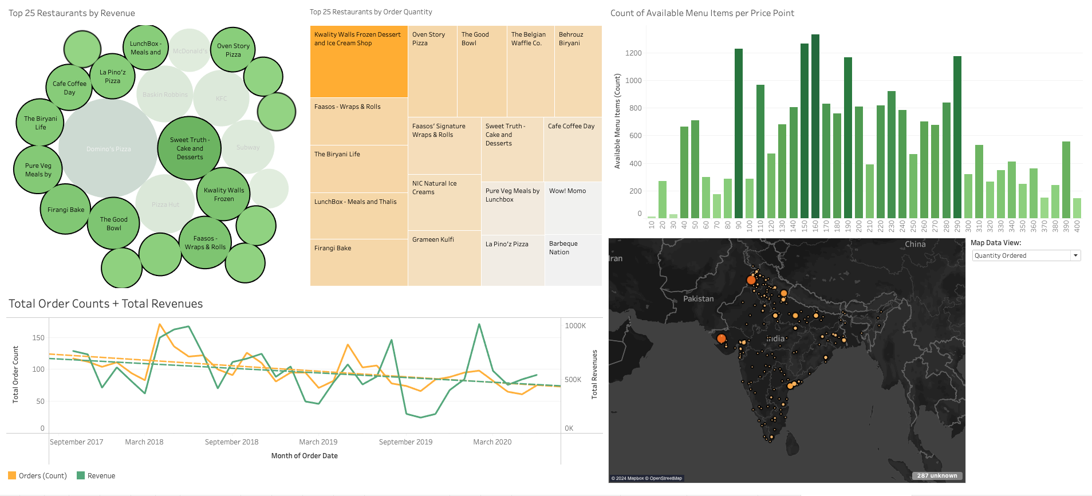
Excluding American chain establishments, top earning restaurants offer local Indian favorites in addition to similar cuisine offered by American chains (Pizza, sandwiches, fried chicken, ice cream & desserts)
Top restaurants receive orders in similar localities, though in lesser quantities

Slide 8
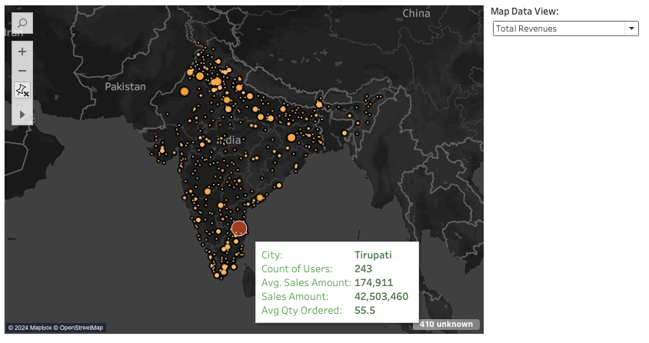
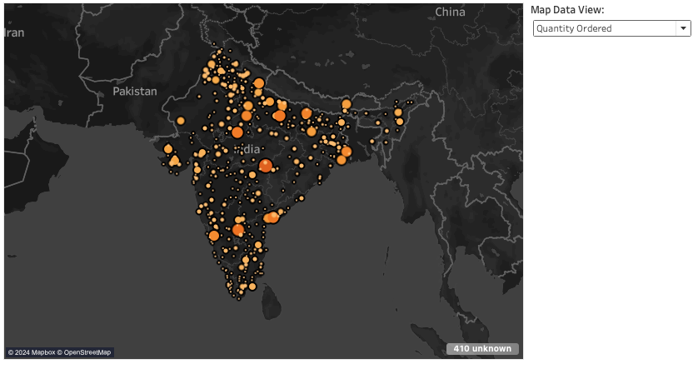
Mild correlation between user counts, quantity ordered, and revenues earned per city
Similar patterns emerge for cities in terms of quantities ordered and users
One city depicts disproportionately high revenues despite not showing high order quantities or a large number of users, due to few unusually large orders placed.
Users are more evenly distributed vs. order quantities and revenues.

Slide 9
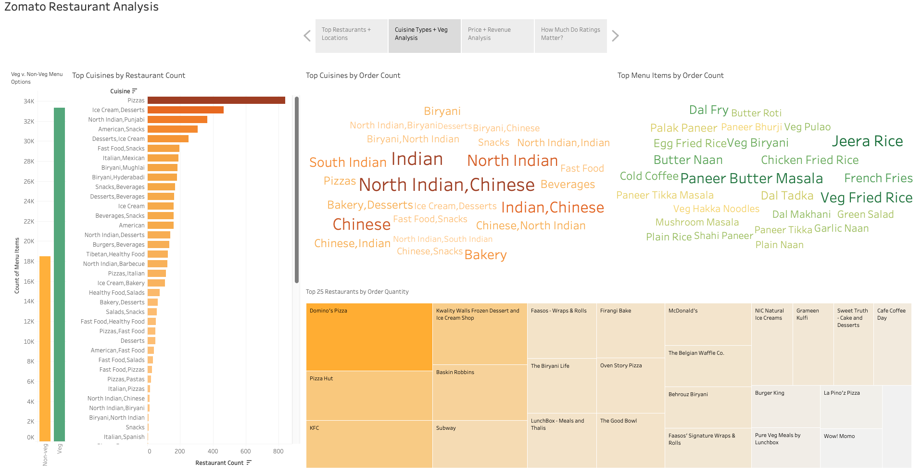
More restaurants offer pizza than anything else by far, however only a few international pizza chains sit in the top 50 restaurants.
Veg options outnumber non-veg options nearly 2:1 as well- having veg options on a menu is most likely imperative for restaurant success.

Slide 10
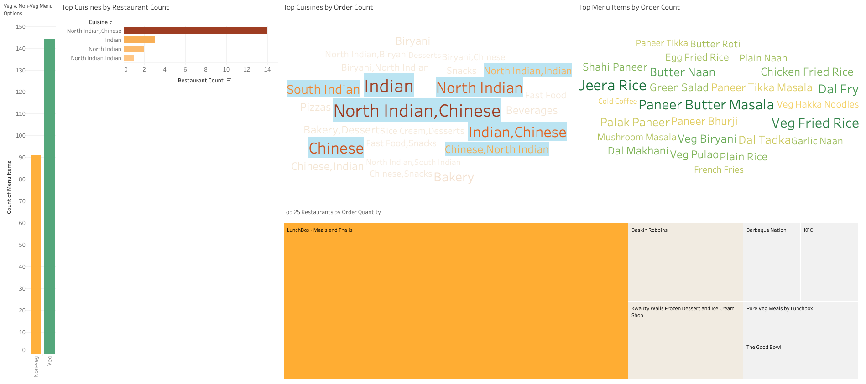
The most ordered cuisines, in contrast to the most common cuisines in restaurants, are more akin to local favorites such as North Indian and Chinese, more likely coming from local establishments.
Most ordered menu items reflect this trend as well.

Slide 11
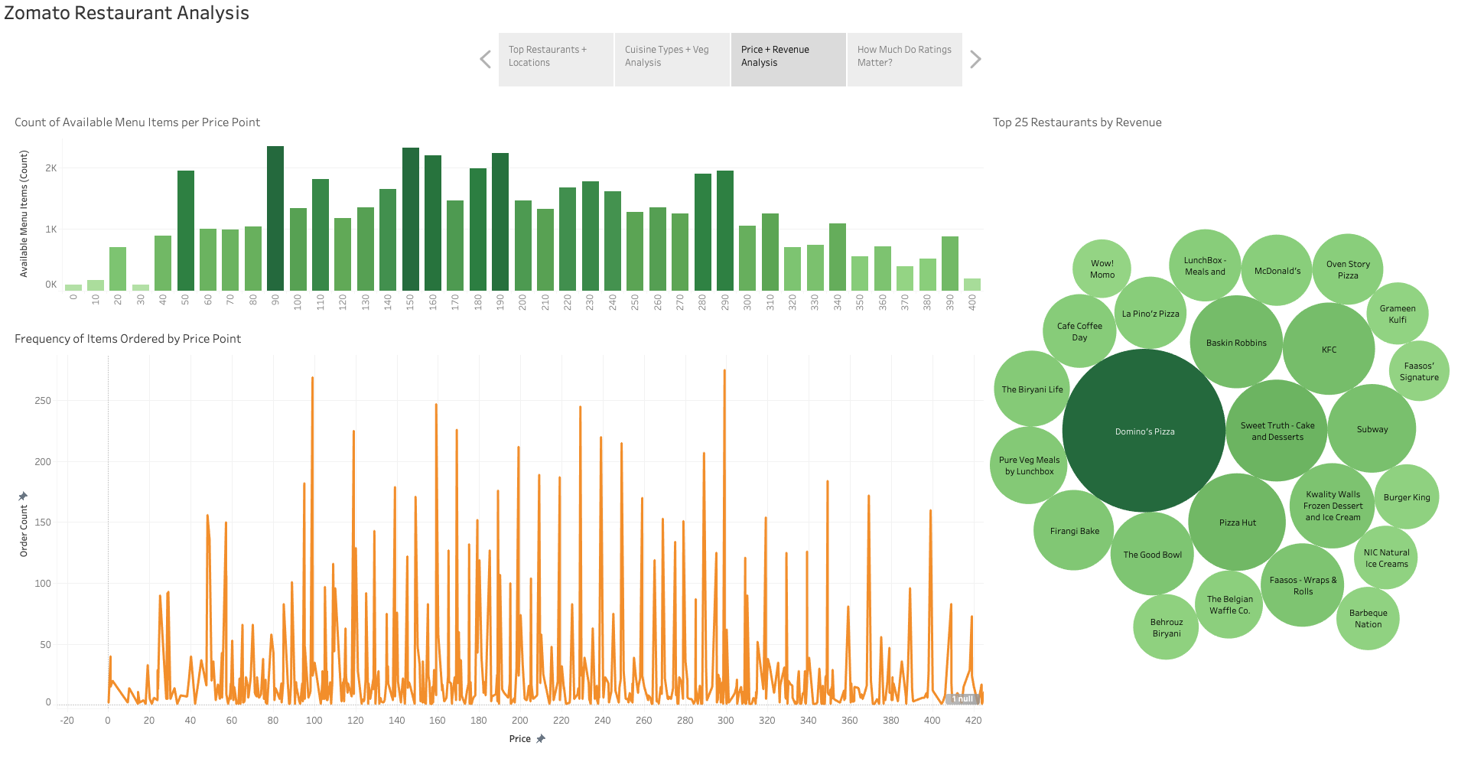
Most menu items offered are priced between 50-300.
Visual shown cuts off pricing at 400, though items do exist above that price point, they appear to be statistical outliers from the majority.
Most items ordered are priced between 99 – 299.

Slide 12
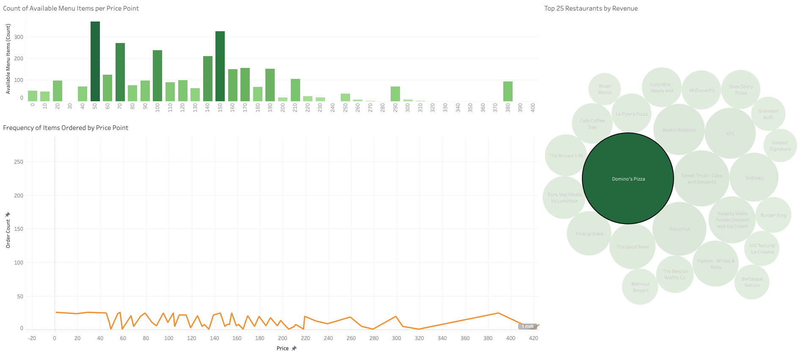
Top earning restaurant Dominos Pizza offers a vast majority of its menu items at a price of 50-150
Competitive pricing will be key for any restaurant aiming for higher revenues

Slide 13
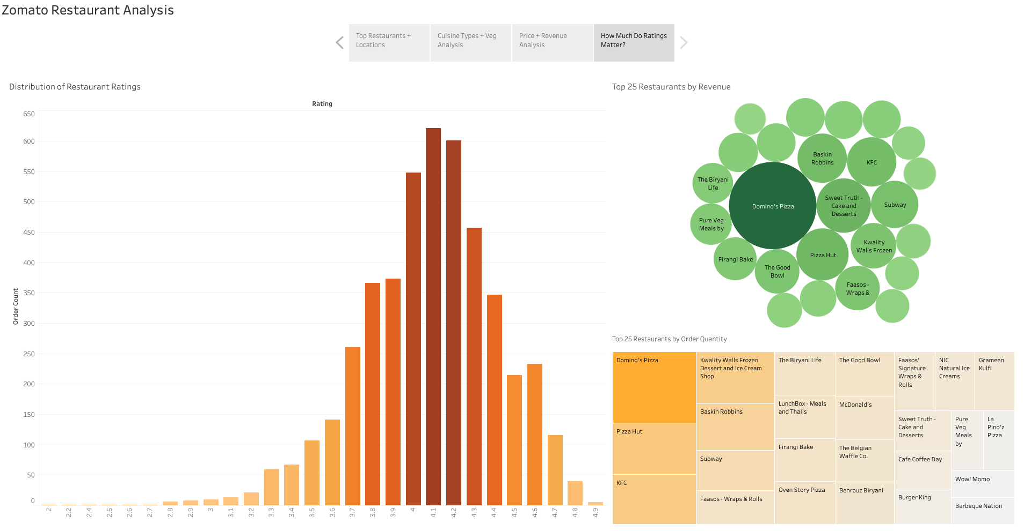
Restaurants most frequently ordered from have an average rating of 4 – 4.2 stars.
Ratings above 4.2 still receive a significant number of orders, though not nearly as many.
Ratings below 4 stars drop off very quickly- restaurants should not allow their ratings to dip below 4 stars.

Slide 14
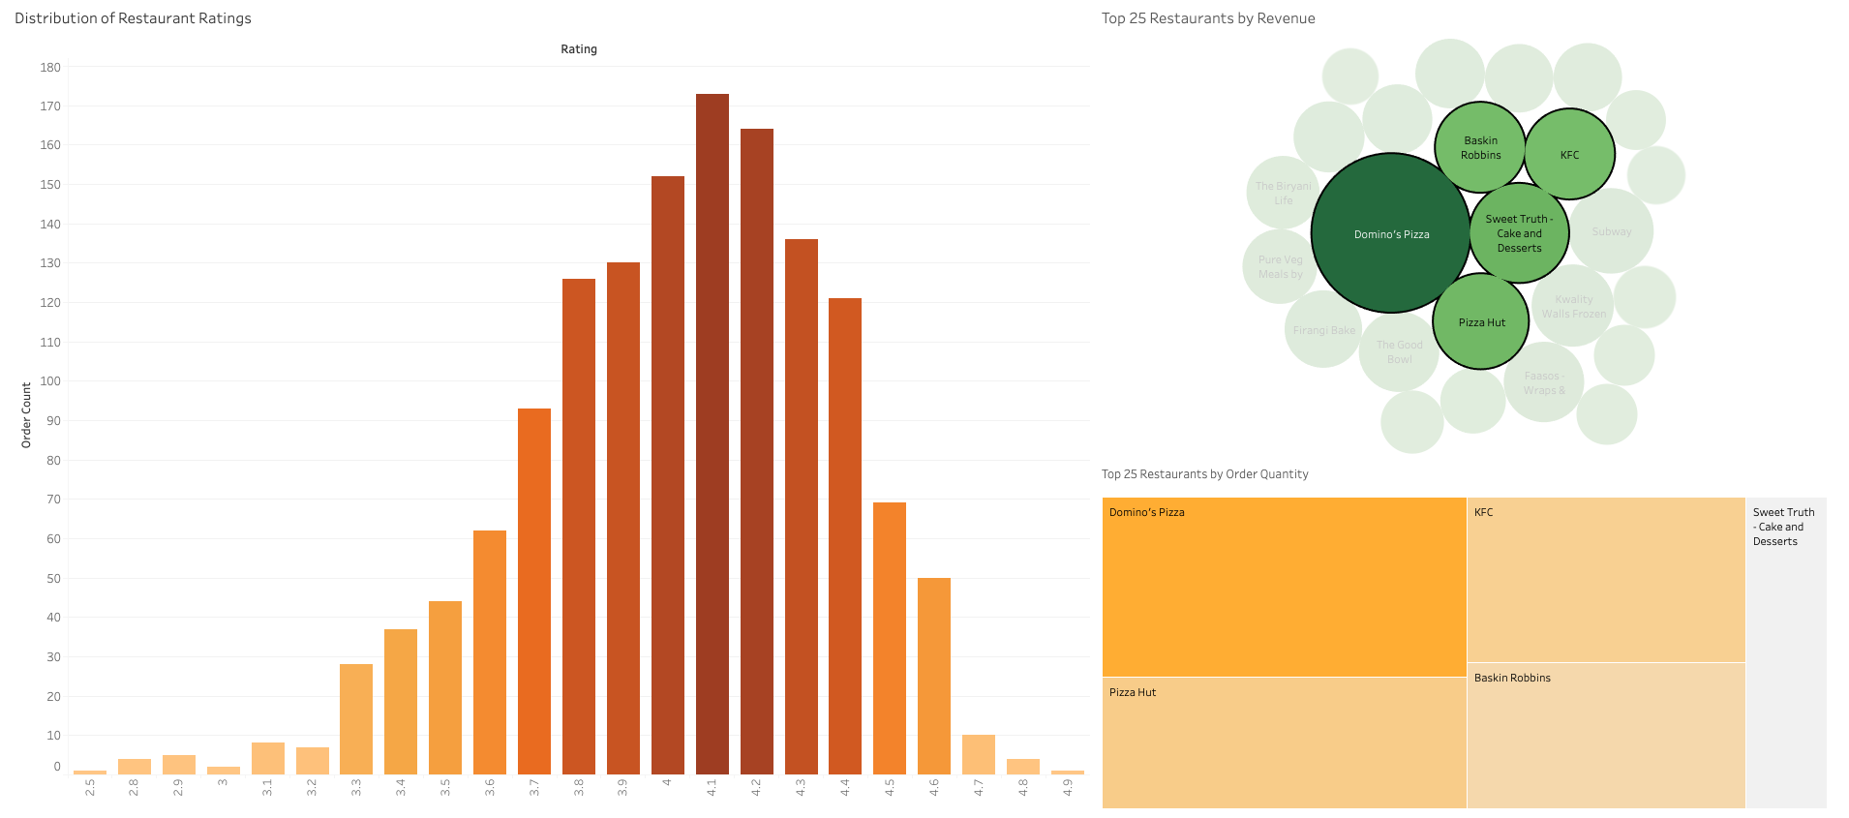
Top 5 earning restaurants reflect this trend with ratings falling between 4 – 4.2.

Slide 15
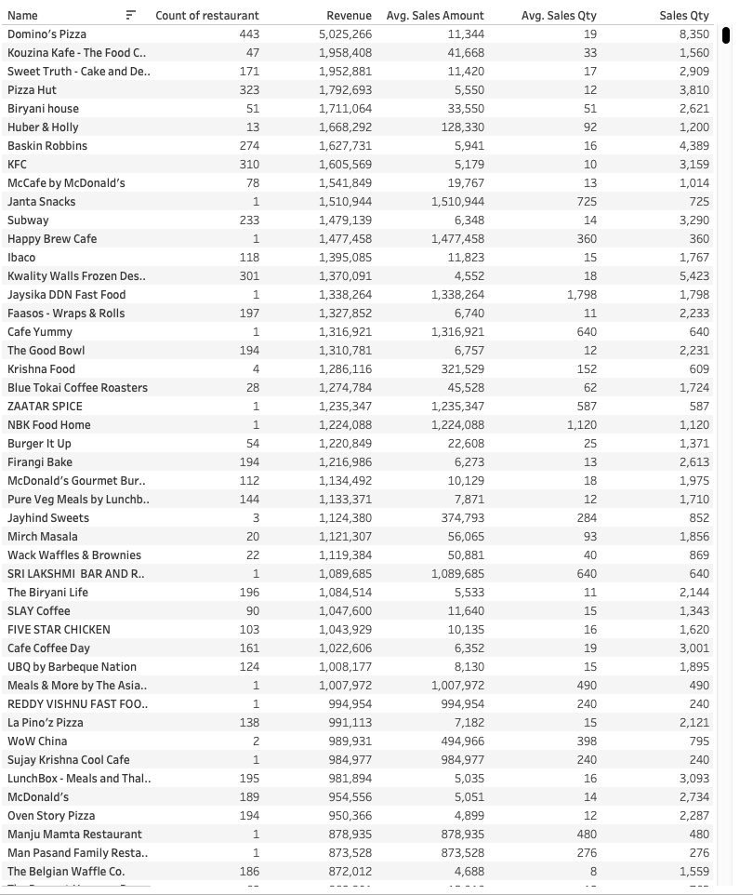
Conclusions + notes
Restaurants serving local Indian and Chinese favorites win out in addition to chains, so long as their location and price point meet the customer where they are at.
Further studies as to why user base is much less active in certain cities could provide insight and potential opportunities for Zomato.
Further study into percentage of veg options offered and ordered could provide potential opportunities as well- errors incurred with tables calculating these percentages that were unable to be solved.

Slide 16
Thank you
Eric Praniewicz | Tripleten | BIA

